Slide 1
Motion-Triggered
Security Camera
MOTION DETECTED
Moving Objects: 1
Using OpenCV: frame differencing and contour tracking
CSC 126 · Computer Vision · Midterm Project
[Name 1] · [Name 2] · [Name 3]
Notes:
Member 1 · 0:00-0:45. Greet the class, introduce the team and the project title. Script: Presentation_Script.md, Slide 1.

Slide 2



The Problem
Expensive
Tiring
Wasteful
Commercial security systems cost too much for small homes and shops
Watching camera footage all day is exhausting and unreliable
24/7 recording fills storage, and most footage has no activity
Our solution: a low-cost webcam system that stays idle and reacts only when something moves.
Notes:
Member 1 · 0:45-2:00. Expensive systems, tiring to watch, wasteful storage. Then introduce the solution.

Slide 3
Objectives
1
Prepare frames with image operations
2
Separate moving regions from the background (segmentation)
3
Detect, track, and count moving objects
4
Show status, object count, date and time on screen
5
Auto-save timestamped screenshots when motion occurs
Notes:
Member 1 · 2:00-3:00. Read the four main objectives, then pass to Member 2.

Slide 4
Techniques Used
Image Operations
resize · cvtColor · GaussianBlur
a
Standardize frames, convert to grayscale, remove camera noise
Image Segmentation
absdiff · threshold · dilate
b
Build a binary motion mask from frame differences
Motion and Object Tracking
findContours · contourArea · boundingRect
e
Detect, filter, and box the moving objects
Notes:
Member 2 · 3:00-5:00. Explain each topic: a. image operations, b. segmentation, e. motion tracking.

Slide 5
Processing Pipeline
1
2
3
4
Capture a video frame
Resize, grayscale, Gaussian blur
absdiff with the previous frame
Threshold (25) and dilate
5
6
7
8
Find contours, keep area > 3000
Draw boxes, status, count, time
Save screenshot (5 s cooldown)
Show frame and motion mask
a. Image Operations
b. Segmentation
e. Motion Tracking
Output
The current frame becomes the previous frame in the next loop.
Notes:
Member 2 · 5:00-6:00. Walk through the 8 steps left to right. Stress the last line: current frame becomes previous frame.

Slide 6
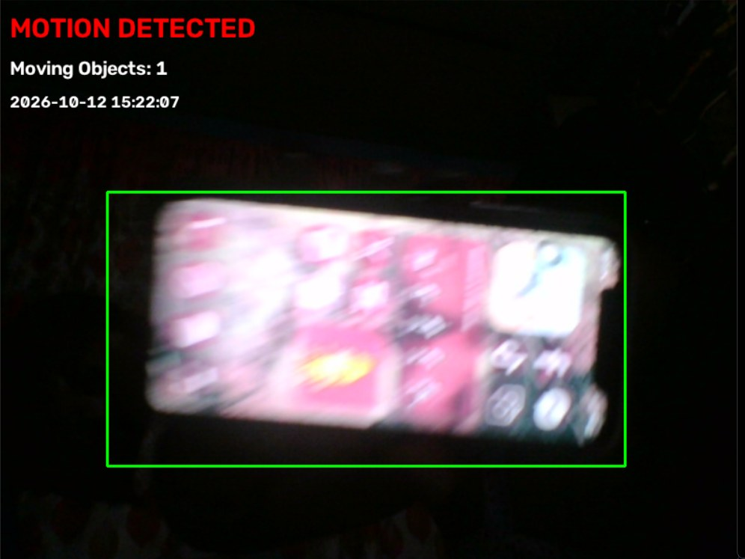
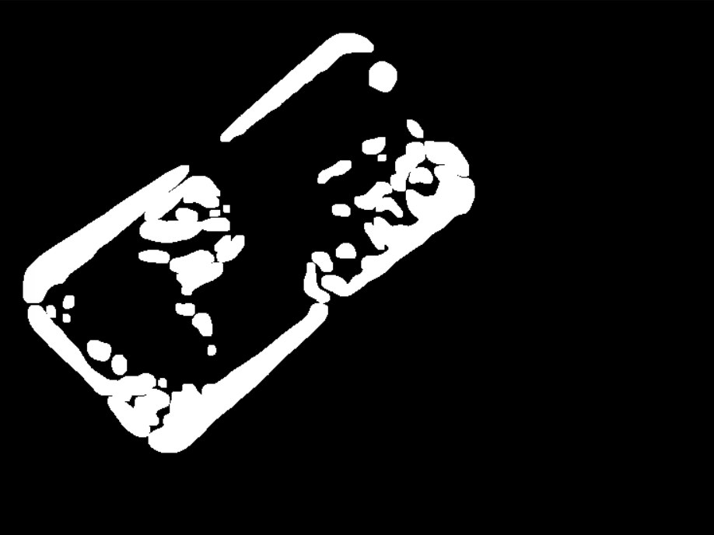
How Frame Differencing Works
1. Camera frame
2. Motion mask
Static areas become black. Moving areas become white.
Notes:
Member 2 · 6:00-6:45. Left: camera frame with the detected phone. Right: the motion mask. absdiff + threshold + dilate turn changed pixels white and static pixels black.

Slide 7
Settings and Testing Results
Program settings (default)
Frame size | 800 × 600
Blur kernel | 21 × 21
Threshold | 25
MIN_CONTOUR_AREA | 3000 px
CAPTURE_COOLDOWN | 5 sec
Min area / threshold / dilation: A 500 / 20 / 2 · B 3000 / 25 / 2 · C 5000 / 30 / 3
Test B kept as default: cleaner boxes (about 2 per frame vs 9 for Test A). Test A is best when small movement matters.
Notes:
Member 2 · 6:45-8:15. All 3 tests used the same 272-frame video. Detection rate = sensitivity, not accuracy. Test C missed small movement. All three detected large and slow movement.

Slide 8
Live Demo
1
Stay still: MONITORING, count 0
MONITORING
2
Wave a hand: MOTION DETECTED + box
MOTION DETECTED
3
Two moving objects: count goes up
python main.py
4
Stop moving: back to MONITORING
Press Q to quit
Backup: samples/demo.mp4
5
captures/ folder: saved screenshots
Notes:
Member 3 · 8:15-11:45. Run python main.py with the Motion Mask window beside the main window. If the webcam fails, set CAMERA_INDEX to samples/demo.mp4.

Slide 9
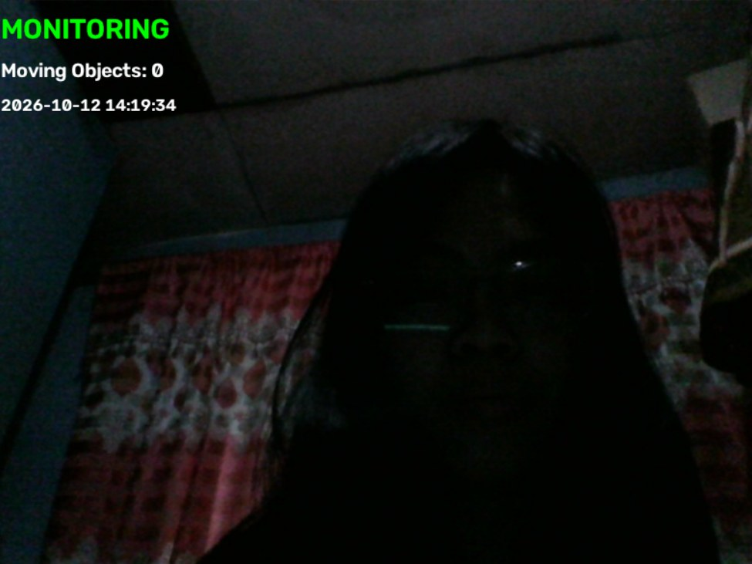
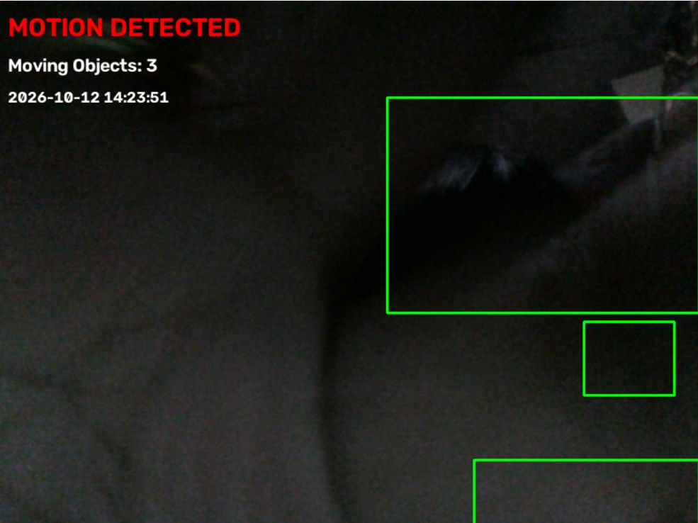
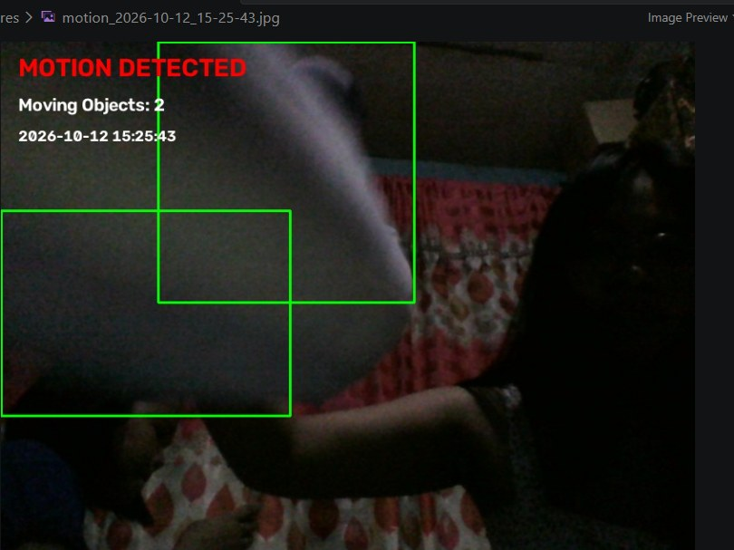
Results
Monitoring
Motion detected
Saved capture
Green status, count 0, nothing is moving
Red status, bounding boxes, count, date and time
Timestamped screenshot saved in captures/
Notes:
Member 1 · 11:45-12:15. Output is clear: status, boxes, count, date and time, and the saved screenshot includes all overlays.

Slide 10






Limitations
Lighting and shadows
Slow or stopped objects
Merged or split boxes
Sudden brightness changes and moving shadows can trigger false motion
Only consecutive frames are compared, so stopped objects disappear
Nearby objects can merge into one box, so the count is approximate
No identification
Camera movement
Limited testing
It sees movement, but cannot tell a person from an animal
If the camera shakes, the whole frame looks like motion
All tests used one video; more scenes and lighting are needed
Notes:
Member 1 · 12:15-13:30. Be honest about limitations. Test C missed small movement; only one video was tested.

Slide 11






Possible Improvements
Background subtraction
Video clips
MOG2 handles lighting changes and slow movement better
Record short clips, not only images
Region of interest
Person check
Only important areas trigger alerts
Use a Haar cascade to confirm a person is present
Alerts
More testing
Sound, email, or SMS notifications
More videos, lighting conditions, and movement speeds
Notes:
Member 2 · 13:30-14:15. Mention MOG2 background subtraction first, then the rest.

Slide 12

Conclusion
Preprocessing strongly affects detection quality
Thank you!
Questions?
Parameter tuning balances sensitivity and false alarms
github.com/bevvy-boop/motion-security-camera
Classical OpenCV can solve a real problem without machine learning
Code · README · samples · screenshots · testing
Notes:
Member 3 · 14:15-15:00. State the key learnings, show the GitHub link, then open for Q&A.

